Slide 1
Aspect-based Sentiment Analysis
Guoxin Yu
2022-04-22

Slide 2
Task Introduction
Learning Implicit Sentiment in ABSA with Contrastive Pre-Training
Dual-graph Network for ABSA
Span-level Model for Aspect Sentiment Triplet Extraction

Slide 3
1
Task Introduction

Slide 4
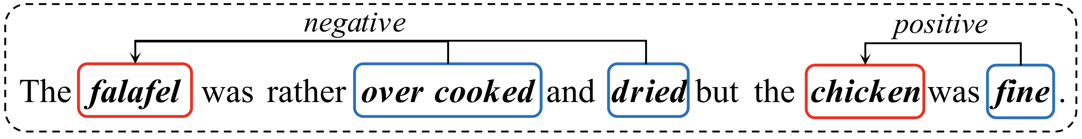
Aspect-based Sentiment Analysis
Aspect-based Sentiment Analysis (ABSA) aims to analize a subjective consciousness of human beings towards an aspect (objective existence).
ATE extracts the aspect terms with obvious emotion inclinations.
OTE aims to extract the opinion terms that express emotions.
ASC predicts the sentiment polarities of aspect terms in the given sentence.
ACD detect the category of aspect terms.
Notes:
按照任务个数分，单个任务，多个任务，新型任务

Slide 5
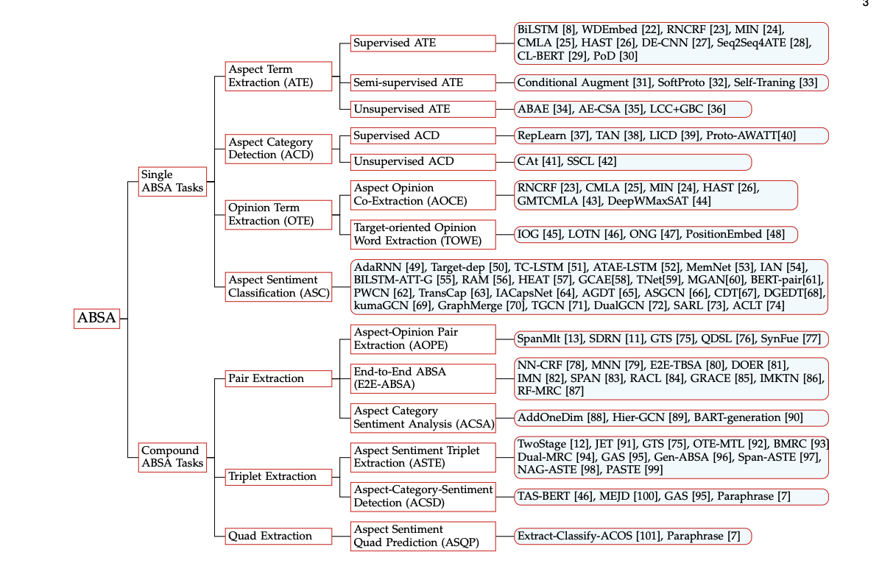
Taxonomy of ABSA tasks
Zhang W, Li X, Deng Y, et al. A Survey on Aspect-Based Sentiment Analysis: Tasks, Methods, and Challenges[J]. arXiv preprint arXiv:2203.01054, 2022.

Slide 6
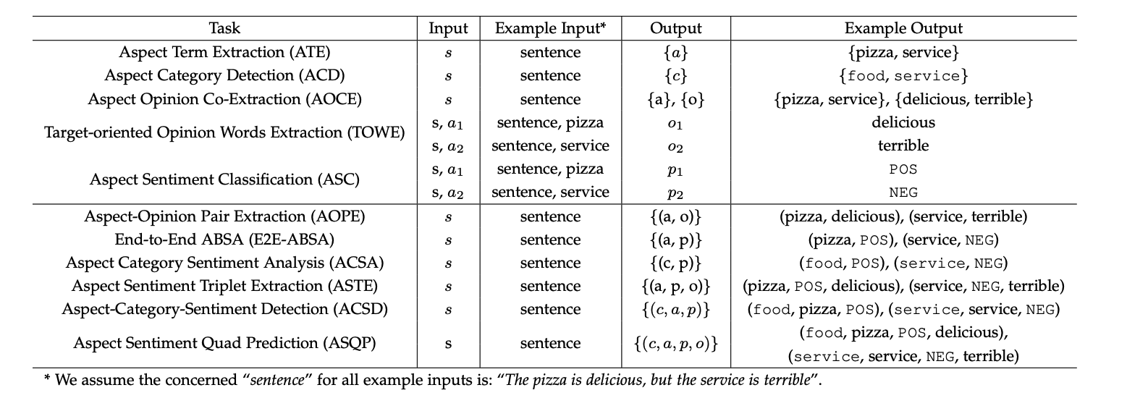
The Formulations of ABSA
Zhang W, Li X, Deng Y, et al. A Survey on Aspect-Based Sentiment Analysis: Tasks, Methods, and Challenges[J]. arXiv preprint arXiv:2203.01054, 2022.

Slide 7
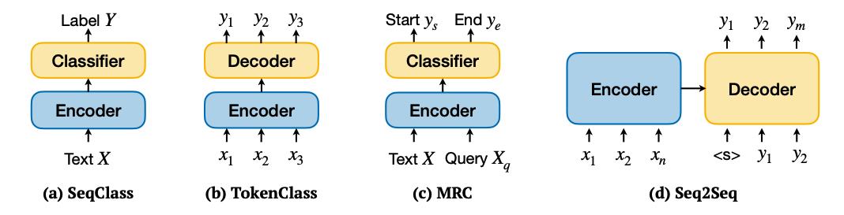
Mainstream Paradigms for ABSA tasks
Zhang W, Li X, Deng Y, et al. A Survey on Aspect-Based Sentiment Analysis: Tasks, Methods, and Challenges[J]. arXiv preprint arXiv:2203.01054, 2022.

Slide 8
2
Learning Implicit Sentiment in ABSA with Contrastive Pre-Training

Slide 9
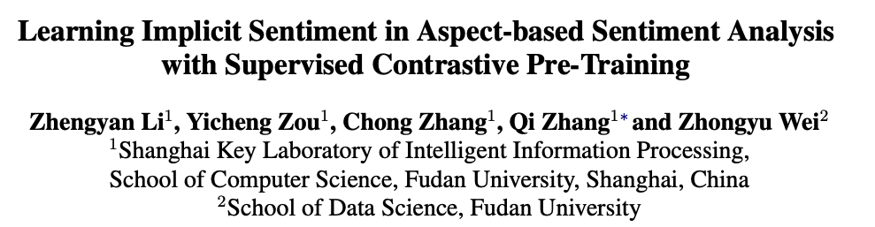
Paper 1 - EMNLP 2021 (for ASC)
Li Z, Zou Y, Zhang C, et al. Learning Implicit Sentiment in Aspect-based Sentiment Analysis with Supervised Contrastive Pre-Training[C]//Proceedings of the 2021 Conference on Empirical Methods in Natural Language Processing. 2021: 246-256.

Slide 10
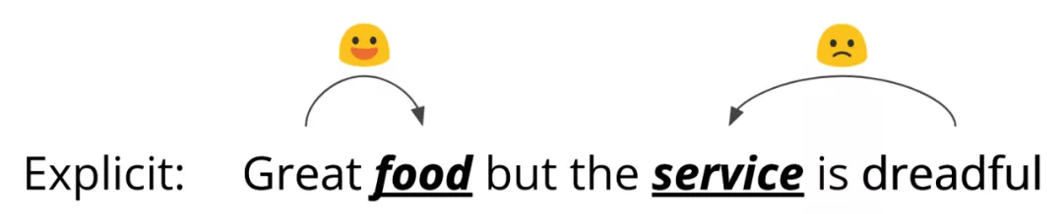
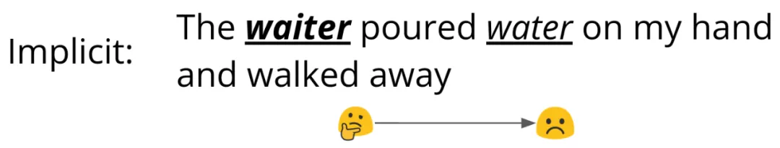
Introduction
This authors split srntiment into explicit sentiment and implicit sentiment.
They commit to detect the explicit sentiments.
Li Z, Zou Y, Zhang C, et al. Learning Implicit Sentiment in Aspect-based Sentiment Analysis with Supervised Contrastive Pre-Training[C]//Proceedings of the 2021 Conference on Empirical Methods in Natural Language Processing. 2021: 246-256.
Notes:
这篇文章把情感分为显式情感和隐式情感。
显式情感就是aspect的情感有明显的情感词作为主导，比如第一个例子里面food为正情感，这个情感主要由great这个词来主导，同样的service是负情感，这样的情感主要由dreadful引导。
类似的显式情感可以通过CNN啊attention啊之类的技术去捕捉上下文信息，说的更确切一点就是捕捉上下文中对aspect情感发挥主导因素的词，从而准确地进行分类。
而隐式可以看一下下面这个例子，这个例子是说 这个waiter把水洒在我的手上然后就走开了，我们人来判断这个waiter的情感倾向肯定是负面的，
但是呢，在这个waiter的上下文里面，并不能找到一个暗示明显的情感倾向的词，比如说这个poured和walked away，单纯看这几个词也不能说就一定是负面。
所以说，隐式的情感要比显式的情感更难以判断和识别，那么这篇文章就主要致力于解决对隐式情感的识别和判断。

Slide 11
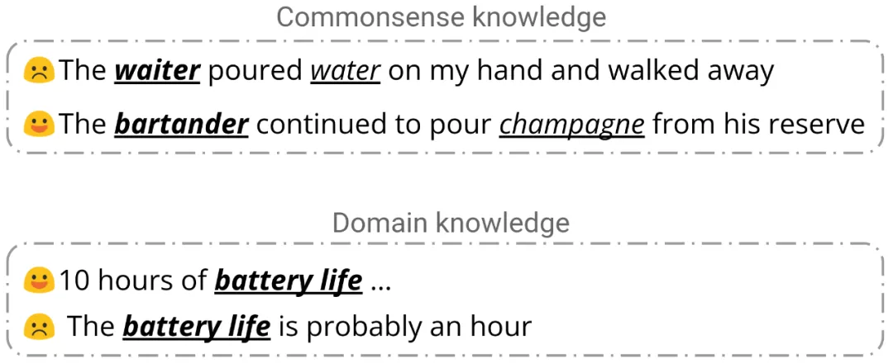
Introduction
They further attributed the implicit sentiment to commonsense knowledge and domain knowledge.
Li Z, Zou Y, Zhang C, et al. Learning Implicit Sentiment in Aspect-based Sentiment Analysis with Supervised Contrastive Pre-Training[C]//Proceedings of the 2021 Conference on Empirical Methods in Natural Language Processing. 2021: 246-256.
Notes:
紧跟着作者又对隐式情感的来源进行了分析，他们进一步将隐式情感的判断归结于常识知识和领域知识。
在上面的两条评论中，相同的动作“泼，倒”(pour)在不同的事件场景中表达出不同的情感，而对这两种情感的判断凭据是常识知识；
在下面的两条评论中，针对笔记本电源寿命，十小时和一小时表述了对立的情感倾向，而这种判断来源于笔记本电源寿命的领域知识。

Slide 12
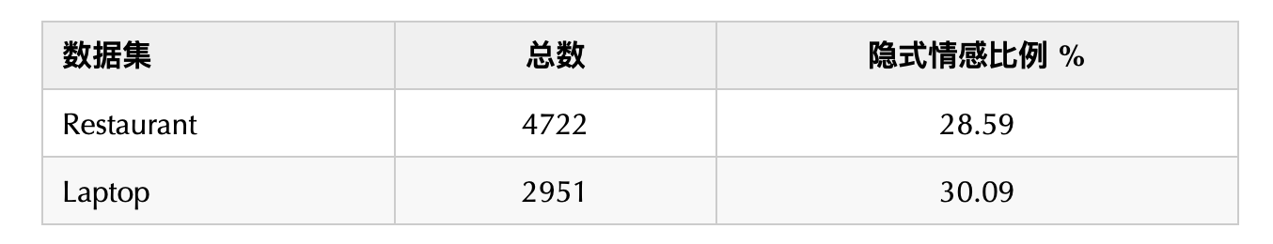
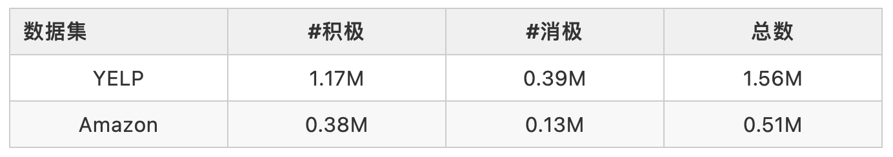
Introduction
Li Z, Zou Y, Zhang C, et al. Learning Implicit Sentiment in Aspect-based Sentiment Analysis with Supervised Contrastive Pre-Training[C]//Proceedings of the 2021 Conference on Empirical Methods in Natural Language Processing. 2021: 246-256.
Notes:
然后作者又进一步证明了探究隐式情感分类的必要性，具体的做法就是统计了两类常用数据集里面隐式情感的比例，一个是restaurant领域，一个是laptop领域
数据结果表明，隐式情感在细粒度情感分析中占据不可忽视的比例，而以往的方法并没有对隐式情感的学习进行深入研究。
基于上面的分析，隐式情感主要来自常识知识和领域知识，但是现有的用于细粒度情感分析的数据集太小了，不足以学到这两类知识
因此作者就借助了外部大规模数据的帮助，具体地是利用yelp和amazon这两个大规模的句子级别的情感分类数据集进行预训练。
那具体是怎么做的呢，作者对这两个大规模数据集进行了筛选，只留下了包含ABSA数据集的aspect的那些句子。
然后表格就显示了筛选后的数据集的数据，可以看到数据量相对于ABSA是很大的，用这个数据集进行预训练，能够帮助模型学习到领域知识和常识知识。

Slide 13
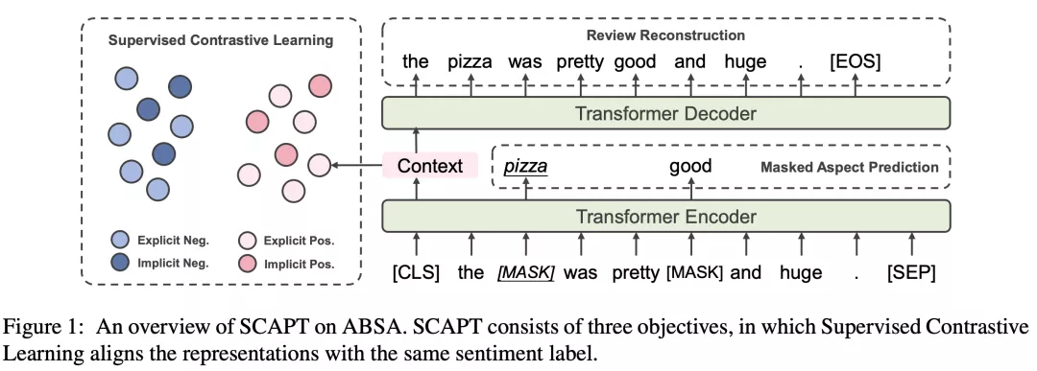
Supervised Contrastive Pre-training
Supervised Contrastive Learning
Review Reconstruction
Masked Aspect Prediction
Li Z, Zou Y, Zhang C, et al. Learning Implicit Sentiment in Aspect-based Sentiment Analysis with Supervised Contrastive Pre-Training[C]//Proceedings of the 2021 Conference on Empirical Methods in Natural Language Processing. 2021: 246-256.
Notes:
然后下面就介绍一下具体的模型，主要包含两个部分：有监督对比预训练，和aspect感知的微调
下面先介绍有监督的对比预训练，图中是具体的结构。
预训练所使用的基础模型为Transformer Encoder，主要分为三个部分：
有监督对比学习 (Supervised Contrastive Learning) 让标签相似的样例的表示尽可能相近
评论重建 (Review Reconstruction) 使文本表示保持原有的意思
方面词预测 (Masked Aspect Prediction)。 对方面词进行学习

Slide 14
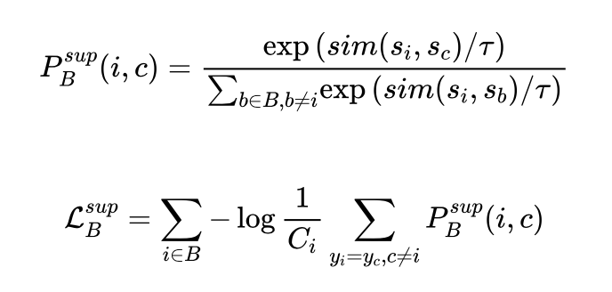
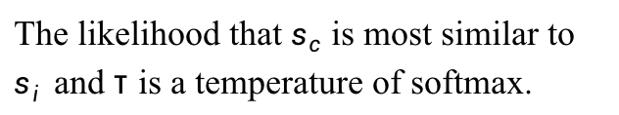
Supervised Constrastive Learning
The supervised contrastive loss is defined as follows:
The likelihood that $s_{c}$ is most similar to $s_{i}$ and τ is a temperature of softmax.
Li Z, Zou Y, Zhang C, et al. Learning Implicit Sentiment in Aspect-based Sentiment Analysis with Supervised Contrastive Pre-Training[C]//Proceedings of the 2021 Conference on Empirical Methods in Natural Language Processing. 2021: 246-256.
Notes:
有监督对比学习最初用于计算机视觉中的分类任务，由无监督的对比学习发展而来。
在预训练中，该目标使得具有相同标签的方面级情感具有相似的情感表示，由此模型能够将无论为显式还是隐式的情感表示，根据其情感倾向性投射到对应的向量空间中。
在有监督对比学习中，给定一个 Batch 中的评论与其标签 , 我们首先得到其情感表示$s_{i}=W_{s}h_{i}$ ，其中$h_{i}$为句子在 [CLS] 位置的表示。之后得到对比学习 Loss 为：

Slide 15
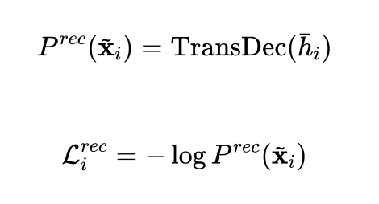
Review Reconstruction
Feed the sentence representation to Tansformer decoder for auto-regressive generation.
Li Z, Zou Y, Zhang C, et al. Learning Implicit Sentiment in Aspect-based Sentiment Analysis with Supervised Contrastive Pre-Training[C]//Proceedings of the 2021 Conference on Empirical Methods in Natural Language Processing. 2021: 246-256.
Notes:
评论重建的灵感来源于去噪自编码器(denoise auto-encoder)。
其目标为通过句子表示$h_{i}$和一个 Transformer Decoder 将评论文本以自回归的方式重建出来。
引入评论重建目标的目的是防止单一的有监督对比学习目标使句子表示退化，让其包含句子原先的整体信息。评论重建的 Loss 为：

Slide 16
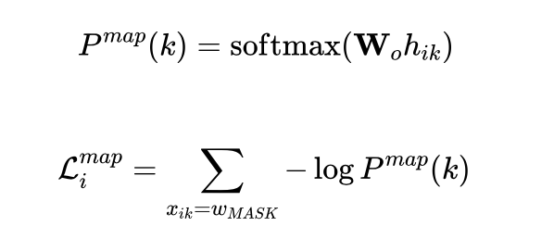
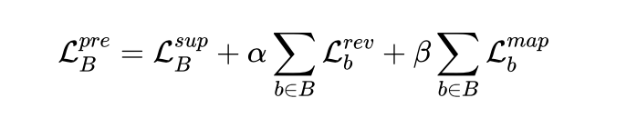
Masked Aspect Prediction
Aspect masking: replace the aspect spans with [MASK] with 80% probs or replace with a random token with 10% probs.
Random masking: randomly mask extra tokens if the proportion of masked tokens is less than15% after aspect masking.
Li Z, Zou Y, Zhang C, et al. Learning Implicit Sentiment in Aspect-based Sentiment Analysis with Supervised Contrastive Pre-Training[C]//Proceedings of the 2021 Conference on Empirical Methods in Natural Language Processing. 2021: 246-256.
Notes:
在预训练中，我们希望模型注意到方面词的信息，并且建模方面词为之后的方面感知的微调做准备。类似于在众多预训练模型中应用的完型填空任务，方面词预测任务要求模型根据方面词位置表示预测得到原先的方面词。
如果将 [MASK] 位置的表示记为$w_{mask}$，则方面词预测的 Loss 为：

Slide 17
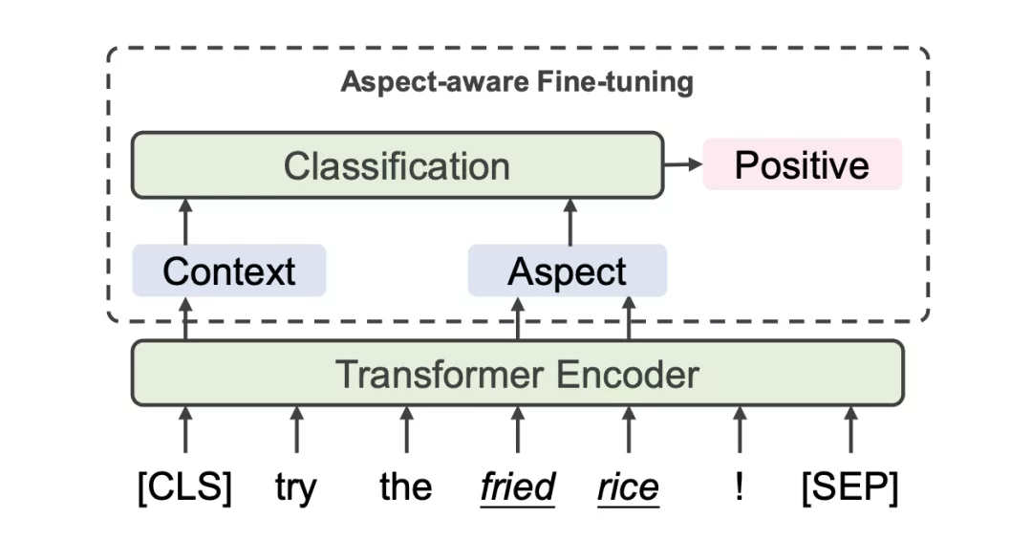
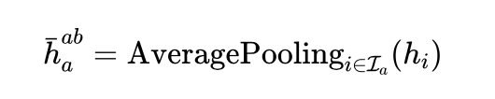
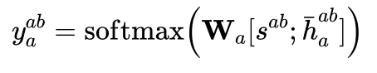
Aspect-based Representation Combination
They average the hidden state for all aspect tokens to acquire aspect-based representation.
Then the sentiment representation and aspect representation are concatenated for predicting aspect polarity.
Li Z, Zou Y, Zhang C, et al. Learning Implicit Sentiment in Aspect-based Sentiment Analysis with Supervised Contrastive Pre-Training[C]//Proceedings of the 2021 Conference on Empirical Methods in Natural Language Processing. 2021: 246-256.
Notes:
在方面感知的微调(Aspect-aware fine-tuning)中，句子的情感表示和方面表示融合在一起用于判断细粒度的情感倾向。具体而言，将所有属于该方面词的词表示进行聚合，得到方面词表示 :

Slide 18
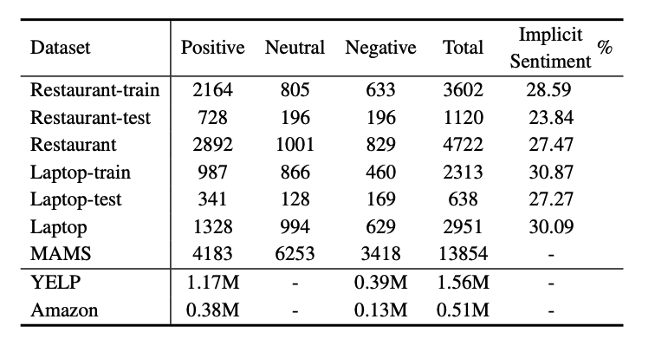
Dataset
Li Z, Zou Y, Zhang C, et al. Learning Implicit Sentiment in Aspect-based Sentiment Analysis with Supervised Contrastive Pre-Training[C]//Proceedings of the 2021 Conference on Empirical Methods in Natural Language Processing. 2021: 246-256.

Slide 19
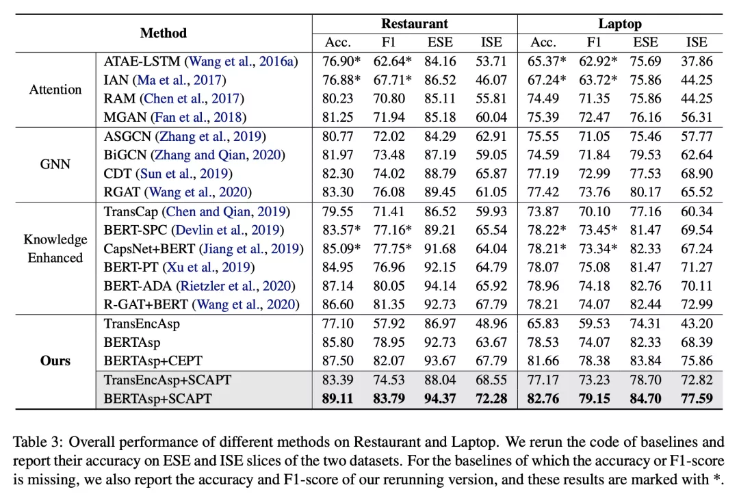
Main Results
Our model achieves SOTA performance.
After pre-trained with SCAPT, models improve significantly on ABSA tasks.
SCAPT is good at learning implicit sentiment.
Aspect-aware fine-tuning serves as a complement to SCAPT.
Li Z, Zou Y, Zhang C, et al. Learning Implicit Sentiment in Aspect-based Sentiment Analysis with Supervised Contrastive Pre-Training[C]//Proceedings of the 2021 Conference on Empirical Methods in Natural Language Processing. 2021: 246-256.
Notes:
基于有监督对比学习预训练和方面感知的微调，我们实现两种主模型：
TransEncAsp+SCAPT：在300维6层6个注意力头的随机初始化 Transformer Encoder上进行预训练和微调的模型
BERTAsp+SCAPT: 基于BERT-base-uncased的模型架构和参数作为基础进行预训练和微调的模型
基于方面感知的微调，我们也实现了一种新的基线模型 BERTAsp，即在预训练模型上直接使用方面感知的微调。
我们将提出的模型与基线模型在 SemEval2014 Restaurant 和 Laptop 上进行了实验，并测试了在显式情感和隐式情感部分的准确率。结果表明：
BERTAsp+SCAPT在两个数据集上均达到了领先的结果；
使用有监督对比学习预训练的模型在隐式情感上具有更好的表现；
BERTAsp超过传统的基于BERT的基线模型，证明了方面感知的微调方法的有效性。

Slide 20
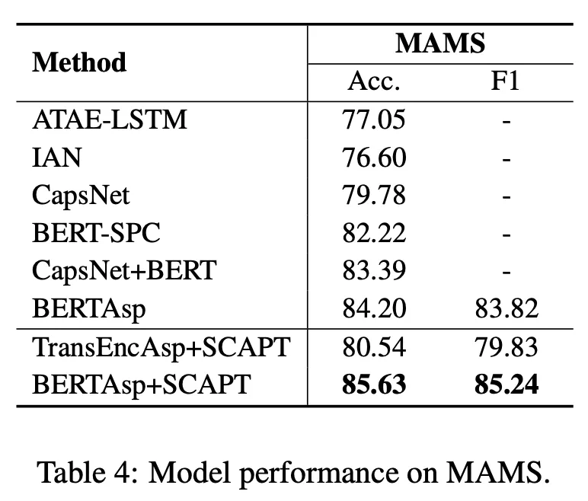
Effectiveness on Multi-aspect ABSA
Li Z, Zou Y, Zhang C, et al. Learning Implicit Sentiment in Aspect-based Sentiment Analysis with Supervised Contrastive Pre-Training[C]//Proceedings of the 2021 Conference on Empirical Methods in Natural Language Processing. 2021: 246-256.
Notes:
我们在多句子多方面词数据集MAMS(Jiang等[3])上验证模型在复杂的细粒度情感分析场景下的表现。实验结果表明，即使在有监督对比学习预训练中，我们抽取的是句子级别的情感表示，但其能够在方面感知的微调的作用下，有效地应对多句子、多方面的复杂场景。

Slide 21
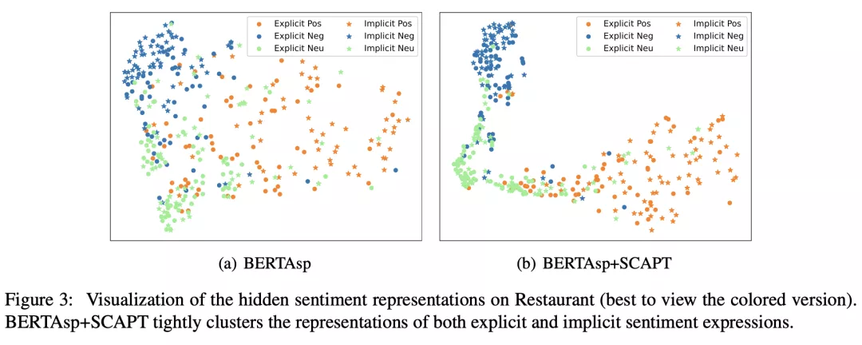
Visualization of implicit sentiment representation
This authors split srntiment into explicit sentiment and implicit sentiment.
They commit to detect the explicit sentiments.
Li Z, Zou Y, Zhang C, et al. Learning Implicit Sentiment in Aspect-based Sentiment Analysis with Supervised Contrastive Pre-Training[C]//Proceedings of the 2021 Conference on Empirical Methods in Natural Language Processing. 2021: 246-256.
Notes:
在 Restaurant 数据集上，使用 T-SNE 将 BERTAsp 和 BERTAsp+SCAPT 中的分类前的表示进行可视化，展示出使用有监督对比学习预训练的模型能够更好地将相同标签的显式情感与隐式情感表示聚合在一起，并且拉远不同情感标签的情感表示。

Slide 22
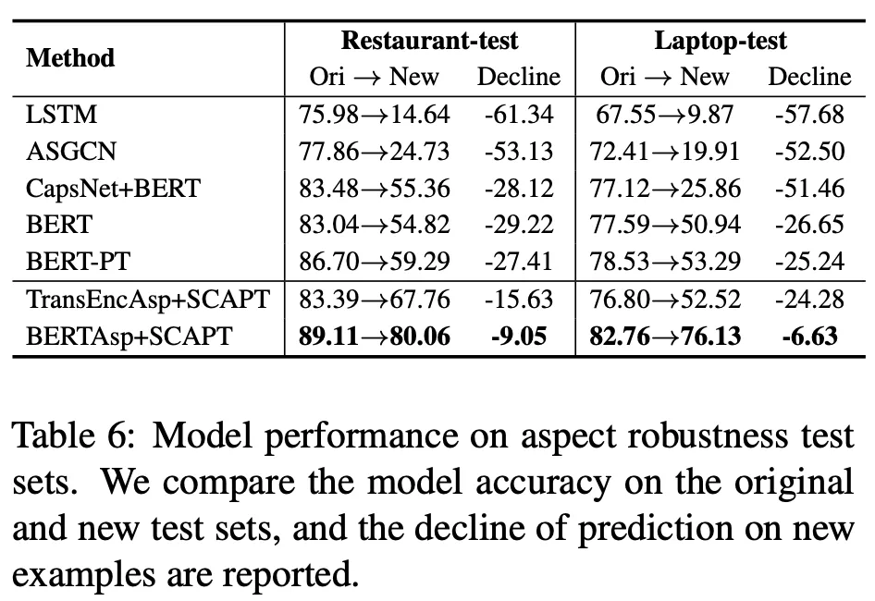
Robustness Test
The test sets are designed to probe whether models could distinguish the sentiment of the target aspect from the non-target aspects and unrelated information.
Li Z, Zou Y, Zhang C, et al. Learning Implicit Sentiment in Aspect-based Sentiment Analysis with Supervised Contrastive Pre-Training[C]//Proceedings of the 2021 Conference on Empirical Methods in Natural Language Processing. 2021: 246-256.
Notes:
我们在鲁棒性测试集上测试了我们的模型。相比于其他基线模型较大的准确率下降，经过有监督对比学习预训练的模型在面对添加方面无关词、添加无用信息等的鲁棒性测试下保持了较高稳定性和健壮性。

Slide 23
Conclusion
Disigned a supervised contrastive pre-training for ABSA
Pay attention to the implicit sentiments
Construct large-scale tagged corpus to learn information for implicit sentiment
Effectively deal with implicit sentiment in data sets.
Li Z, Zou Y, Zhang C, et al. Learning Implicit Sentiment in Aspect-based Sentiment Analysis with Supervised Contrastive Pre-Training[C]//Proceedings of the 2021 Conference on Empirical Methods in Natural Language Processing. 2021: 246-256.
Notes:
在本文中，我们提出一种有监督对比学习预训练(SCAPT)用于学习细粒度情感分析中的隐式情感。
我们发现在隐式情感尚未引起学者的足够重视，而处理隐式情感需要更多的知识。
我们构建了大规模的有标注语料，并使用有监督对比学习预训练(SCAPT)学习隐式情感中的情感知识。
实验证明该方法在细粒度情感分析任务具有领先的表现，并且能够有效地处理数据集中的隐式情感。
我们希望未来通过知识增强的方法，更具体更有效地建模并理解细粒度情感分析中的隐式情感。

Slide 24
3
Dual-graph Network for ABSA

Slide 25
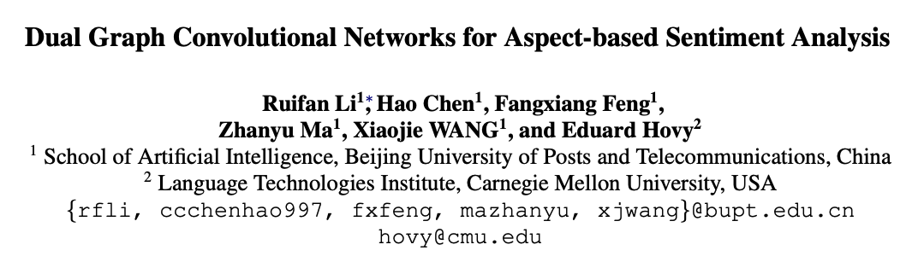
Paper 2 - ACL2021 (for ASC)
Li, Ruifan, et al. "Dual graph convolutional networks for aspect-based sentiment analysis." Proceedings of the 59th Annual Meeting of the Association for Computational Linguistics and the 11th International Joint Conference on Natural Language Processing (Volume 1: Long Papers). 2021.
Notes:
在本文中，我们提出一种有监督对比学习预训练(SCAPT)用于学习细粒度情感分析中的隐式情感。
我们发现在隐式情感尚未引起学者的足够重视，而处理隐式情感需要更多的知识。
我们构建了大规模的有标注语料，并使用有监督对比学习预训练(SCAPT)学习隐式情感中的情感知识。
实验证明该方法在细粒度情感分析任务具有领先的表现，并且能够有效地处理数据集中的隐式情感。
我们希望未来通过知识增强的方法，更具体更有效地建模并理解细粒度情感分析中的隐式情感。

Slide 26
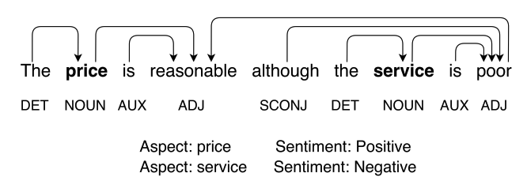
Introduction
RNN with attention mechanisms: attention confusion
GNN over dependency trees: 1) the inaccuracy of the dependency parsing results
2) GCNs over dependency trees do not work well as expected on datasets that are not sensitive to syntactic dependency due to the informal expression and complexity of online reviews.
Li, Ruifan, et al. "Dual graph convolutional networks for aspect-based sentiment analysis." Proceedings of the 59th Annual Meeting of the Association for Computational Linguistics and the 11th International Joint Conference on Natural Language Processing (Volume 1: Long Papers). 2021.

Slide 27
Introduction
SynGCN: they use the probability matrix of all dependency arcs from a dependency parser to build a syntax-based graph neural network.
SemGNC: they utilize a self-attention mechanism to construct semantic correlation-based graph convolutional network.
Orthogonai regularizer: encourage SemGCN to learn an orthogonal semantic attention matrix
Differential regularizer: encourage SemGCN to learn semantic features distinct from SynGCN network
Li, Ruifan, et al. "Dual graph convolutional networks for aspect-based sentiment analysis." Proceedings of the 59th Annual Meeting of the Association for Computational Linguistics and the 11th International Joint Conference on Natural Language Processing (Volume 1: Long Papers). 2021.

Slide 28
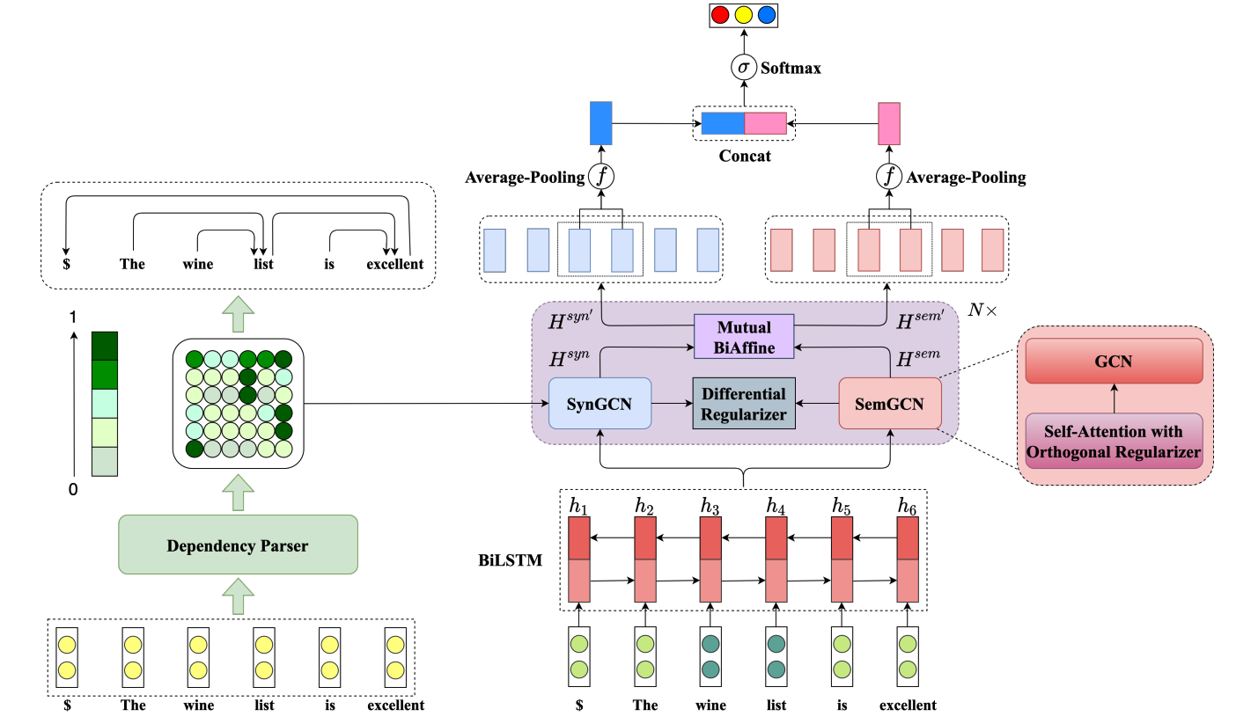
Syntatic GCN
The dependency probability matrix could capture rich structure information by providing all latent syntactic structures.
LAL-Parser
Li, Ruifan, et al. "Dual graph convolutional networks for aspect-based sentiment analysis." Proceedings of the 59th Annual Meeting of the Association for Computational Linguistics and the 11th International Joint Conference on Natural Language Processing (Volume 1: Long Papers). 2021.
Notes:
与以往句法树不同的是，本文使用的是概率矩阵，也就是使用依赖树解析工具得到的这个矩阵不是一个0-1矩阵，而是每个位置的值都是一个0到1的小数。
这样可以一定程度上缓解解析树解析错误带来的负面影响。

Slide 29
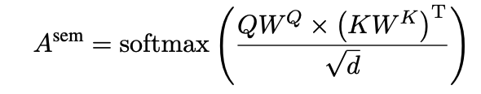
Semantic GCN
Li, Ruifan, et al. "Dual graph convolutional networks for aspect-based sentiment analysis." Proceedings of the 59th Annual Meeting of the Association for Computational Linguistics and the 11th International Joint Conference on Natural Language Processing (Volume 1: Long Papers). 2021.
Notes:
semantic GCN就是将self-attention的计算结果看成一个全联接图的权重，从而学到句子的语义信息。

Slide 30
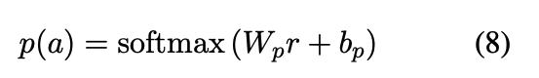
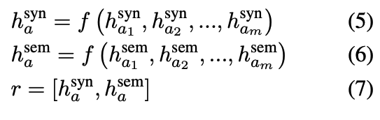
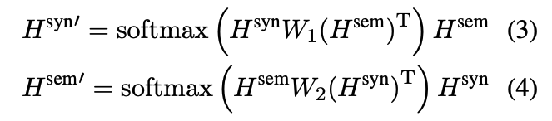
BiAffine Module
Li, Ruifan, et al. "Dual graph convolutional networks for aspect-based sentiment analysis." Proceedings of the 59th Annual Meeting of the Association for Computational Linguistics and the 11th International Joint Conference on Natural Language Processing (Volume 1: Long Papers). 2021.
Notes:
刚刚介绍了两种GCN的构图方法，下面讲通过两种GCN学完特征以后的模型结构。
这里我的理解是利用两种GCN学到的表示，计算了量个attention，一种是syngcn学到的表示做Q，semgcn学到的表示做K和V，计算得到一个新的syngcn的表示。
那么另一种就是Q和K反过来。
随后呢，利用得到的这两个新的表示，分别取aspect相应未知的representation分别做average pooling。
把pooling得到的结果concat一下，再过一个分类器得到最后的类别。

Slide 31
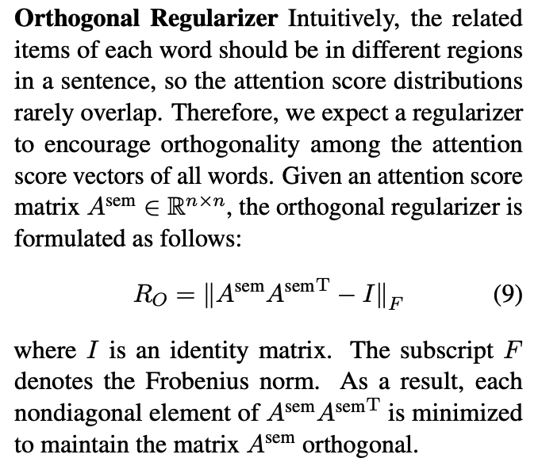
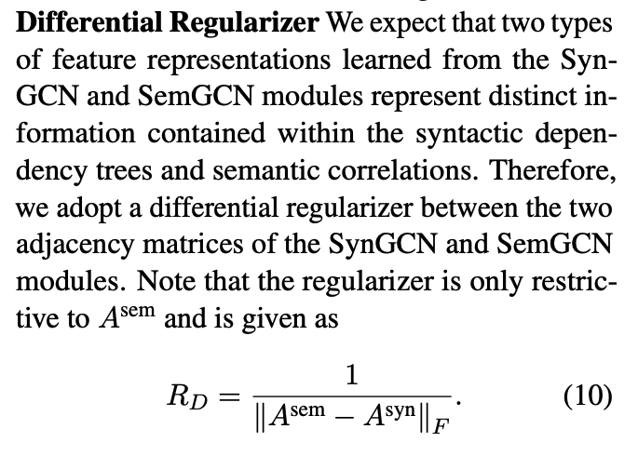
Regularizer
Li, Ruifan, et al. "Dual graph convolutional networks for aspect-based sentiment analysis." Proceedings of the 59th Annual Meeting of the Association for Computational Linguistics and the 11th International Joint Conference on Natural Language Processing (Volume 1: Long Papers). 2021.
Notes:
这里的正交正则化，是使得semGCN的邻接矩阵尽可能的正交化，他这里给出的理由是每一个单词相对于句子里面的其他词的attention应该是不尽相同的
这里具体的操作就是尽可能的最小化这个attention矩阵乘以他的转置减去单位矩阵。
这个differential regularizer就更好理解了，它的作用就是让两个图尽可能的不一样。

Slide 32
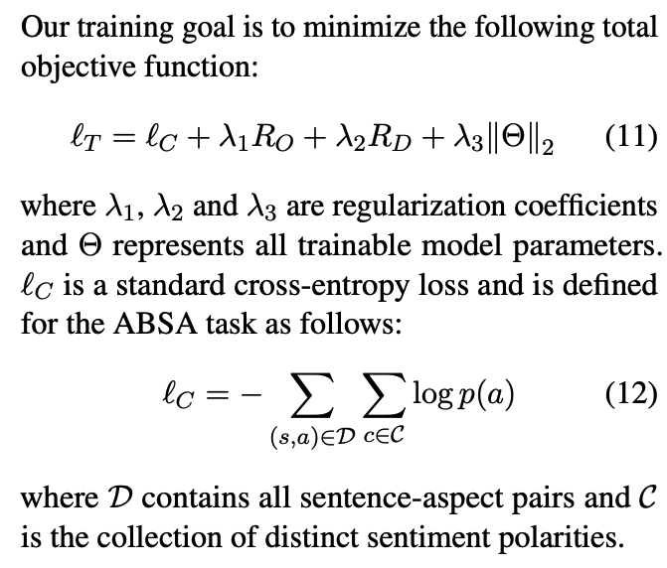
Loss Function
Li, Ruifan, et al. "Dual graph convolutional networks for aspect-based sentiment analysis." Proceedings of the 59th Annual Meeting of the Association for Computational Linguistics and the 11th International Joint Conference on Natural Language Processing (Volume 1: Long Papers). 2021.

Slide 33
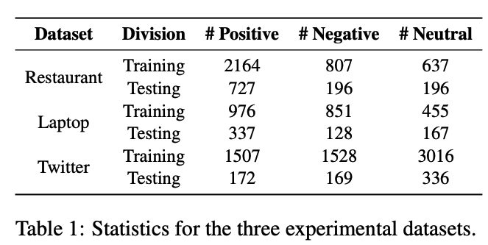
Dataset
Li, Ruifan, et al. "Dual graph convolutional networks for aspect-based sentiment analysis." Proceedings of the 59th Annual Meeting of the Association for Computational Linguistics and the 11th International Joint Conference on Natural Language Processing (Volume 1: Long Papers). 2021.

Slide 34
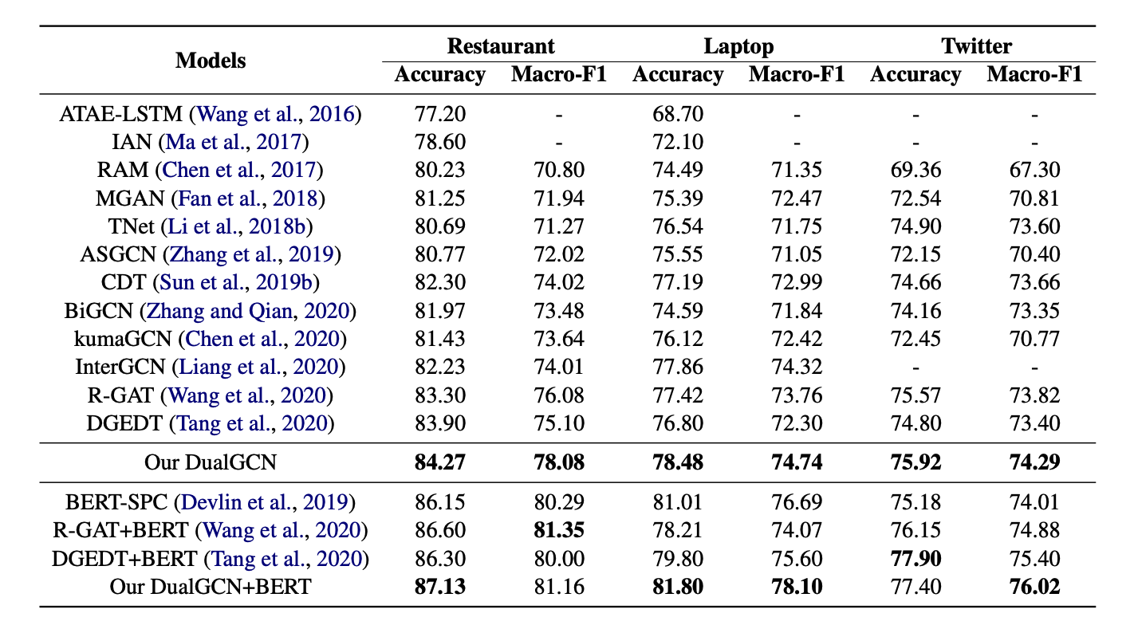
Main Results
Li, Ruifan, et al. "Dual graph convolutional networks for aspect-based sentiment analysis." Proceedings of the 59th Annual Meeting of the Association for Computational Linguistics and the 11th International Joint Conference on Natural Language Processing (Volume 1: Long Papers). 2021.
Notes:
紫色dualgcn比所有的attention方法都好，证明学到了句法和语义信息。
dualgcn在三个数据集上表现都好，说明在不同类型的数据集，比如formal informal的数据集上都有用。Twitter比较informal，
attention方法学到的是语义信息，graph方法学到的是句法信息，数据集更需要句法信息。

Slide 35
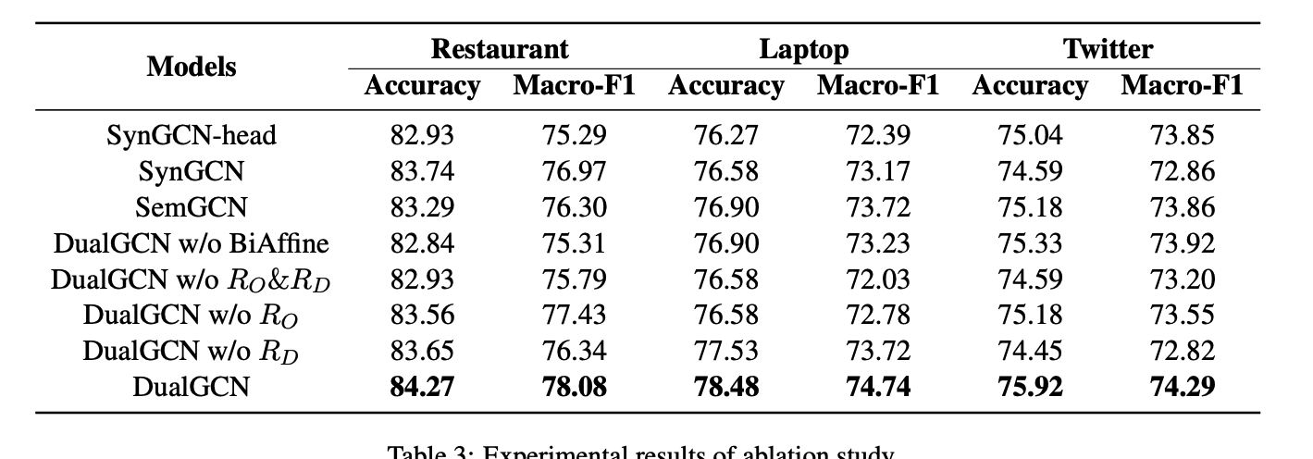
Ablation Results
Li, Ruifan, et al. "Dual graph convolutional networks for aspect-based sentiment analysis." Proceedings of the 59th Annual Meeting of the Association for Computational Linguistics and the 11th International Joint Conference on Natural Language Processing (Volume 1: Long Papers). 2021.
Notes:
紫色Twitter数据集比较informal，对句法信息不敏感。其他数据集相对好一点，句法信息也起到了比较重要的作用。再res和lap上syngcn更高，印证了main results里面说的句法信息更有用。
红色说明两种GCN学到的特征之间交互的重要性。
绿色说明正则化的有效性

Slide 36
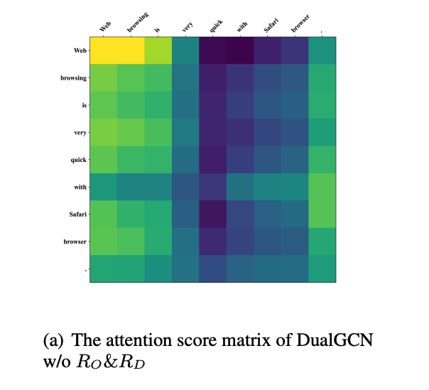
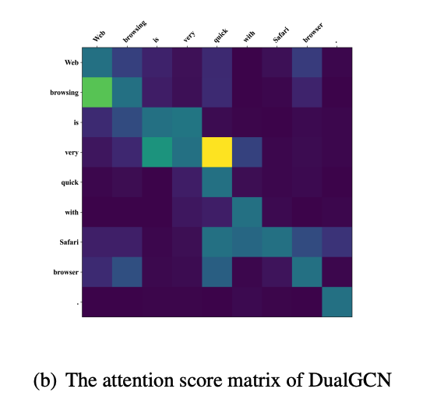
Visualization
Li, Ruifan, et al. "Dual graph convolutional networks for aspect-based sentiment analysis." Proceedings of the 59th Annual Meeting of the Association for Computational Linguistics and the 11th International Joint Conference on Natural Language Processing (Volume 1: Long Papers). 2021.
Notes:
这个可视化是为了验证两个正则化方法对图的影响
左图没有正则化，每个单词的权重分布就比较相似，比如说这个very和这个quick相对于其他词的权重分布是很像的。dense
作者把这个现象归结于没有用orthogonal regularizer约束。这样的语义信息的重叠会导致信息传递过程中的冗余和噪声。
右图比较sparse，Safari browser能够和相应的opinion word “quick”相连，有较大的权重。

Slide 37
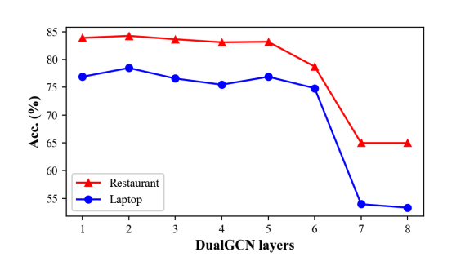
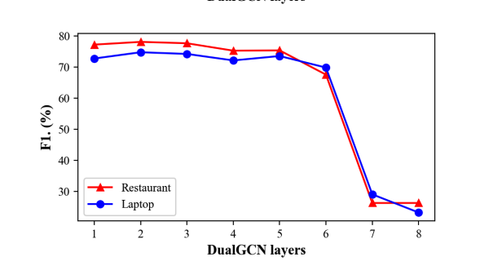
The Effect of GCN layers
Li, Ruifan, et al. "Dual graph convolutional networks for aspect-based sentiment analysis." Proceedings of the 59th Annual Meeting of the Association for Computational Linguistics and the 11th International Joint Conference on Natural Language Processing (Volume 1: Long Papers). 2021.
Notes:
两层最好。
层数太少的话，远距离信息传递不过去。
层数太多容易导致梯度消失或者信息冗余。
其实这里我认为层数太多的话，有图相当于没有图，因为特征聚合次数太多了，所有的节点表示都会趋近相同。

Slide 38
Conclusion
Dual-GCN: SynGCN and SemGNC construct semantic correlation-based graph convolutional network.
Two regularizer: Orthogonai regularizer and Differential regularizer
Biaffine Module
Li, Ruifan, et al. "Dual graph convolutional networks for aspect-based sentiment analysis." Proceedings of the 59th Annual Meeting of the Association for Computational Linguistics and the 11th International Joint Conference on Natural Language Processing (Volume 1: Long Papers). 2021.
Notes:
这里的正交正则化，是使得semGCN的邻接矩阵尽可能的正交化，他这里给出的理由是每一个单词相对于句子里面的其他词的attention应该是不尽相同的
这里具体的操作就是尽可能的最小化这个attention矩阵乘以他的转置减去单位矩阵。
这个differential regularizer就更好理解了，它的作用就是让两个图尽可能的不一样。

Slide 39
4
Span-level Model for Aspect Sentiment Triplet Extraction

Slide 40
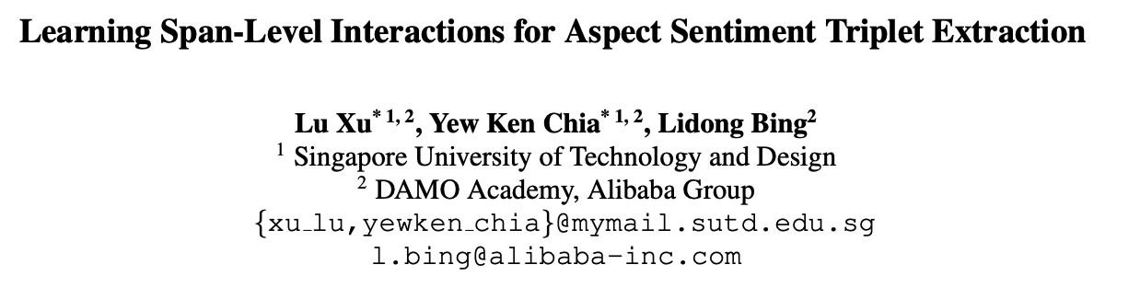
Paper 3 - ACL2021 ( for ASTE)
Xu, Lu, Yew Ken Chia, and Lidong Bing. "Learning Span-Level Interactions for Aspect Sentiment Triplet Extraction." Proceedings of the 59th Annual Meeting of the Association for Computational Linguistics and the 11th International Joint Conference on Natural Language Processing (Volume 1: Long Papers). 2021.

Slide 41
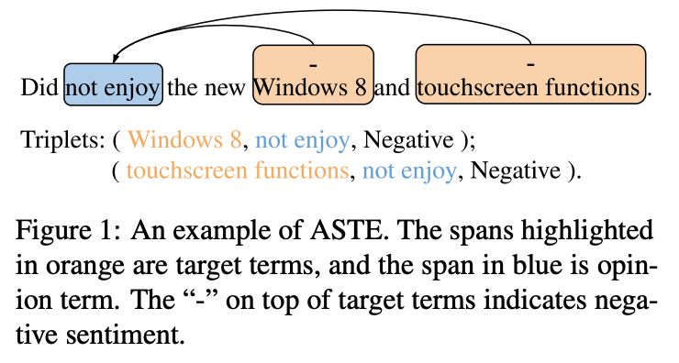
Introduction
Aspect Sentiment Triplet Extraction is the most recently proposed subtask of ABSA, which forms a more complete picture of the sentiment information through the triplet of an aspect target term, the corresponding opinion term, and the expressed sentiment.
Xu, Lu, Yew Ken Chia, and Lidong Bing. "Learning Span-Level Interactions for Aspect Sentiment Triplet Extraction." Proceedings of the 59th Annual Meeting of the Association for Computational Linguistics and the 11th International Joint Conference on Natural Language Processing (Volume 1: Long Papers). 2021.
Notes:
很多的现有任务已经探索了各种方法在给定aspect的情况下进行分类，但是实际场景中aspect不总是已知的，所以这个任务其实更符合真实的场景。

Slide 42
Previous Methods
Pipeline model:
(1) extract all aspect terms and opinion terms, (2)couples them to determine their paired sentiment relations. ( errore propagation )
End-to-end model:
jontly extract the aspect and opinion terms and classify their sentiment relations.
( heavily rely on word-to-word interactions )
Xu, Lu, Yew Ken Chia, and Lidong Bing. "Learning Span-Level Interactions for Aspect Sentiment Triplet Extraction." Proceedings of the 59th Annual Meeting of the Association for Computational Linguistics and the 11th International Joint Conference on Natural Language Processing (Volume 1: Long Papers). 2021.
Notes:
以往模型的分类和对应的缺点

Slide 43
Introduction
Many aspect/opinion terms contain multiple words (>30% in benchmarks)
Existing methods make word-to-word pair prediction ( cannot guarantee their sentiment consistency )
This paper
proposed a span-level approach
( captures the span-to-span interactions for sentiment relations prediction )
proposed a dual-channel span pruning strategy
( ease the high computational cost )
Xu, Lu, Yew Ken Chia, and Lidong Bing. "Learning Span-Level Interactions for Aspect Sentiment Triplet Extraction." Proceedings of the 59th Annual Meeting of the Association for Computational Linguistics and the 11th International Joint Conference on Natural Language Processing (Volume 1: Long Papers). 2021.
Notes:
多个单词组成的term情感不一致的问题，比如说not enjoy如果只考虑enjoy的话，情感会变成正面。
现有的方法都是利用的word-to-word的交互关系，没有利用span和span之间的交互，换言之，就是没有把multiple word aspect和opinion看作一个整体去探索交互。

Slide 44
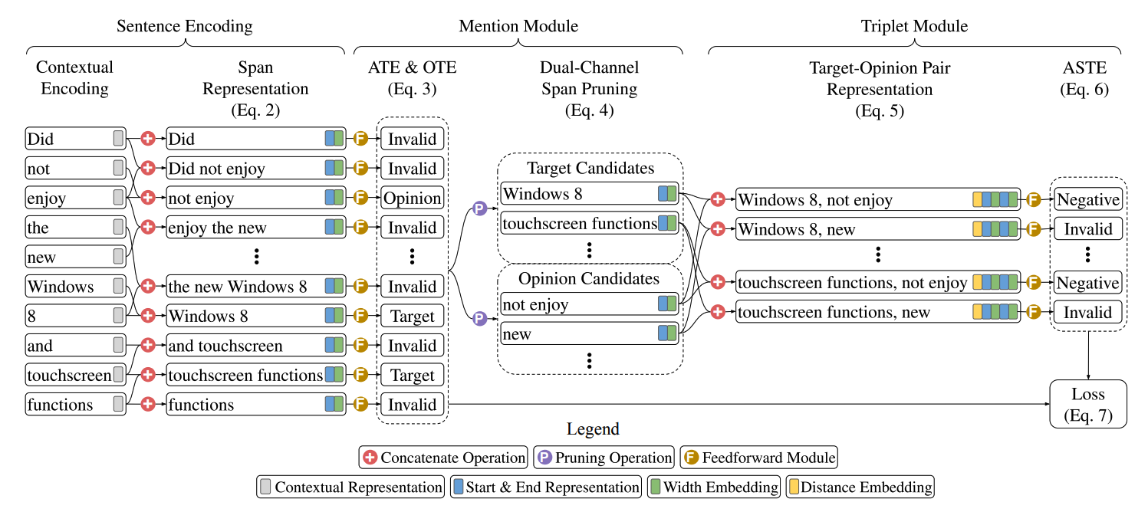
Model
Xu, Lu, Yew Ken Chia, and Lidong Bing. "Learning Span-Level Interactions for Aspect Sentiment Triplet Extraction." Proceedings of the 59th Annual Meeting of the Association for Computational Linguistics and the 11th International Joint Conference on Natural Language Processing (Volume 1: Long Papers). 2021.
Notes:
模型就粉三个部分，

Slide 45
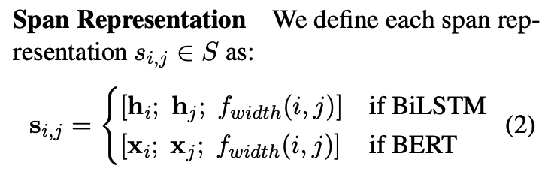
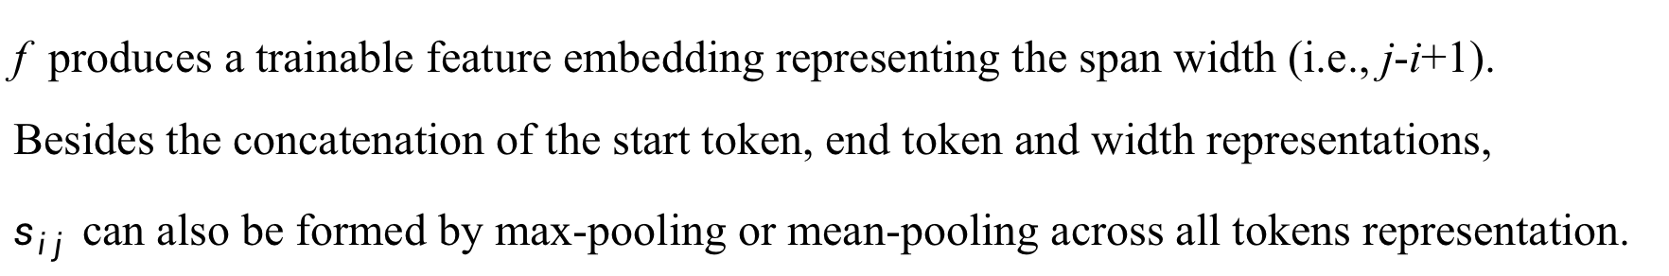
Sentence Encoding
f produces a trainable feature embedding representing the span width (i.e., j-i+1).
Besides the concatenation of the start token, end token and width representations,
$s_{ij}$ can also be formed by max-pooling or mean-pooling across all tokens representation.
Xu, Lu, Yew Ken Chia, and Lidong Bing. "Learning Span-Level Interactions for Aspect Sentiment Triplet Extraction." Proceedings of the 59th Annual Meeting of the Association for Computational Linguistics and the 11th International Joint Conference on Natural Language Processing (Volume 1: Long Papers). 2021.
Notes:
采用bert或者bilstm得到句子表示，然后把每个span的头尾的词concat起来，再加一个f，这样就得到一个span的表示。
f是一个可训练的embedding，与i-j有关。

Slide 46
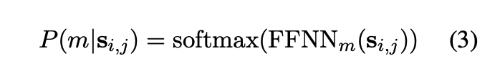
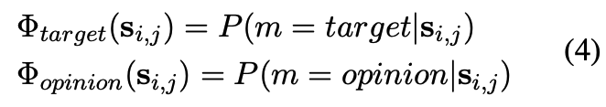
Mention Module
Pruned target and opinion: select the top candidates according to the probabilities.
Although the pruning operation prevents the gradient flow back, it is already receving supervision from ATE and OTE.
Xu, Lu, Yew Ken Chia, and Lidong Bing. "Learning Span-Level Interactions for Aspect Sentiment Triplet Extraction." Proceedings of the 59th Annual Meeting of the Association for Computational Linguistics and the 11th International Joint Conference on Natural Language Processing (Volume 1: Long Papers). 2021.
Notes:
剪枝，因为一个句子的span个数太多，为了减少后面的探索span之间interaction的时候时间复杂度更低一些，需要剪掉一些没有用的span
所以设计了一个双向的剪枝方法，对span进行分类，得到的结果用ATE和OTE的标签监督，然后选概率top k的作为target和opinion，k=nz，n是句子长度，z是一个超参数
虽然这里top k会影响梯度回传，因为top k是不可导的，但是这里又ATE和OTE的监督。

Slide 47
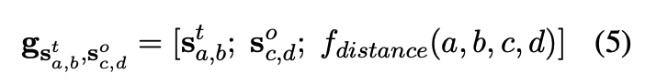
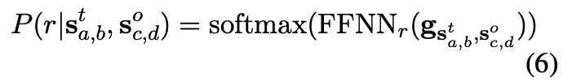
Triplet Module
Target opinion pair representation: concat the candidate target and opinion spans.
Xu, Lu, Yew Ken Chia, and Lidong Bing. "Learning Span-Level Interactions for Aspect Sentiment Triplet Extraction." Proceedings of the 59th Annual Meeting of the Association for Computational Linguistics and the 11th International Joint Conference on Natural Language Processing (Volume 1: Long Papers). 2021.

Slide 48

Training
Xu, Lu, Yew Ken Chia, and Lidong Bing. "Learning Span-Level Interactions for Aspect Sentiment Triplet Extraction." Proceedings of the 59th Annual Meeting of the Association for Computational Linguistics and the 11th International Joint Conference on Natural Language Processing (Volume 1: Long Papers). 2021.

Slide 49

Main Results
Xu, Lu, Yew Ken Chia, and Lidong Bing. "Learning Span-Level Interactions for Aspect Sentiment Triplet Extraction." Proceedings of the 59th Annual Meeting of the Association for Computational Linguistics and the 11th International Joint Conference on Natural Language Processing (Volume 1: Long Papers). 2021.
Notes:
紫色pipeline，红色 end2end，数据集是他们团队根据原始数据集进行标注以后发布的。
end2end比pipeline好
F1最好，高了十几个点，比end2end好，
加Bert baseline也会比原来的模型好。
span-ASTE依然是完胜。

Slide 50

Training
Xu, Lu, Yew Ken Chia, and Lidong Bing. "Learning Span-Level Interactions for Aspect Sentiment Triplet Extraction." Proceedings of the 59th Annual Meeting of the Association for Computational Linguistics and the 11th International Joint Conference on Natural Language Processing (Volume 1: Long Papers). 2021.
Notes:
span level的方法，不仅在情感分析任务上有提升，在抽取任务上也有一定的效果。这个是取的前面一节进行训练，没有剪枝的操作了。

Slide 51

Training
Xu, Lu, Yew Ken Chia, and Lidong Bing. "Learning Span-Level Interactions for Aspect Sentiment Triplet Extraction." Proceedings of the 59th Annual Meeting of the Association for Computational Linguistics and the 11th International Joint Conference on Natural Language Processing (Volume 1: Long Papers). 2021.
Notes:
数据集划分成单个词和多个词的aspect，在multi-word上相比GTS的提升更大。

Slide 52

Training
Xu, Lu, Yew Ken Chia, and Lidong Bing. "Learning Span-Level Interactions for Aspect Sentiment Triplet Extraction." Proceedings of the 59th Annual Meeting of the Association for Computational Linguistics and the 11th International Joint Conference on Natural Language Processing (Volume 1: Long Papers). 2021.
Notes:
在多word的term上的抽取结果。但是这个结果不知道有没有可信度，没有提到测试数据有多少条，很有可能就只有100多条或者几百条，不知道有没有说服性。

Slide 53

Training
Xu, Lu, Yew Ken Chia, and Lidong Bing. "Learning Span-Level Interactions for Aspect Sentiment Triplet Extraction." Proceedings of the 59th Annual Meeting of the Association for Computational Linguistics and the 11th International Joint Conference on Natural Language Processing (Volume 1: Long Papers). 2021.
Notes:
选择top k的nz个，横轴是z，选一半效果好，后面选多了对效果没有提升，但是时间更久，更复杂了

Slide 54

Training
Xu, Lu, Yew Ken Chia, and Lidong Bing. "Learning Span-Level Interactions for Aspect Sentiment Triplet Extraction." Proceedings of the 59th Annual Meeting of the Association for Computational Linguistics and the 11th International Joint Conference on Natural Language Processing (Volume 1: Long Papers). 2021.
Notes:
case study ，左边的证明GTS情感会错，证明了span level的interaction的作用
右边的证明span能够更完整的抽取a和o，这也证明了spanlevel将multiple word看成一个整体的好处。

Slide 55

Training
Xu, Lu, Yew Ken Chia, and Lidong Bing. "Learning Span-Level Interactions for Aspect Sentiment Triplet Extraction." Proceedings of the 59th Annual Meeting of the Association for Computational Linguistics and the 11th International Joint Conference on Natural Language Processing (Volume 1: Long Papers). 2021.
Notes:
做了一个对比说明，获得span representation的方法里面，还是concatenation最好，并且要加上那个可训练的span 长度有关的embedding。

Slide 56
感谢聆听
联系我们：yuguoxin20g@ict.ac.cn

